Slide 1
Interpreting Model Coefficients for Logistic Regression
MSDS 410
Data Modeling for Supervised Learning
Northwestern University
School of Professional Studies

Slide 2
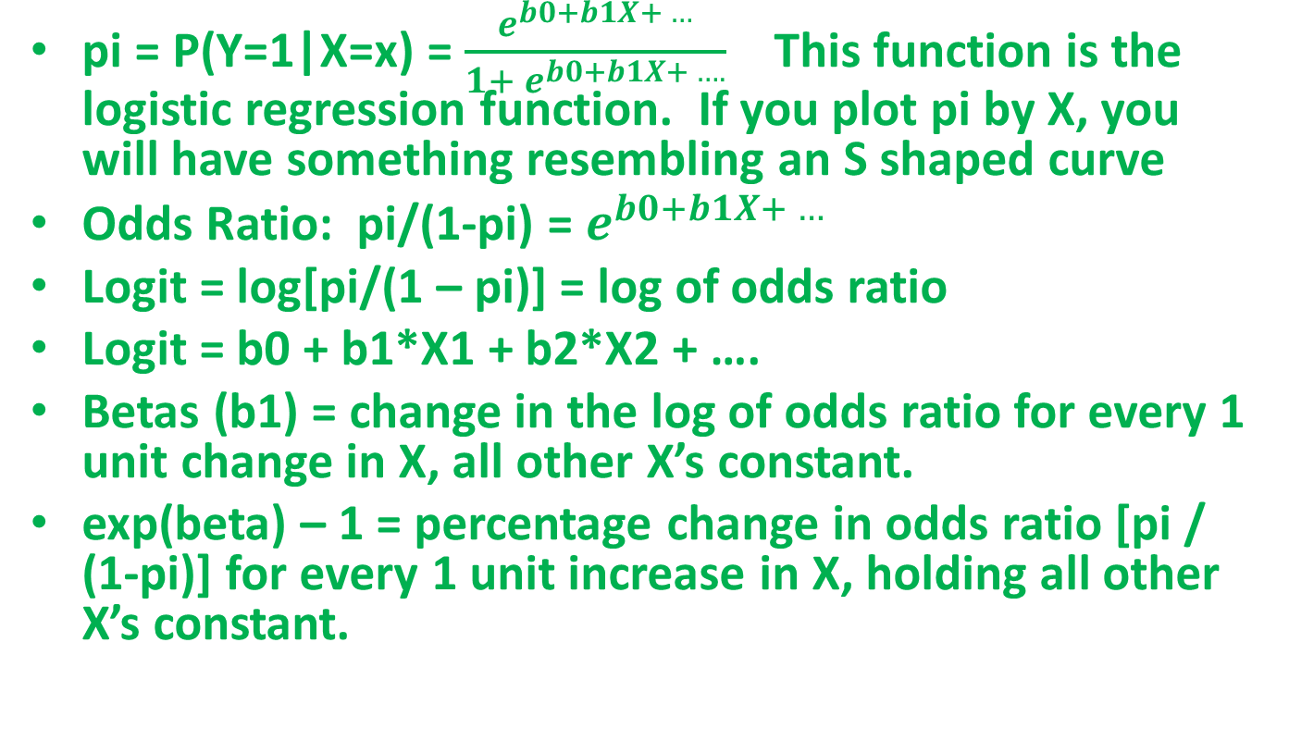
Summary of Key LR Components
and their Interpretations
pi = P(Y=1|X=x) = $\frac{e^{b0+b1X+ …}}{1+ e^{b0+b1X+ ….}}$ This function is the logistic regression function. If you plot pi by X, you will have something resembling an S shaped curve
Odds Ratio: pi/(1-pi) = $e^{b0+b1X+ …}$
Logit = log[pi/(1 – pi)] = log of odds ratio
Logit = b0 + b1*X1 + b2*X2 + ….
Betas (b1) = change in the log of odds ratio for every 1 unit change in X, all other X’s constant.
exp(beta) – 1 = percentage change in odds ratio [pi / (1-pi)] for every 1 unit increase in X, holding all other X’s constant.

Slide 3
Predicting Donner Party Member Survival
Variables (in: donner_party_lr_data)
Age
Sex (1=female, 2=male)
Survival (1=yes, 0=no)
pi = P[y=1] = probability of survival
Odds Ratio = pi / [1 – pi]
Logit = Log(odds ratio) = Log(pi/(1-pi))
Logit = b0 + b1*X1 + b2*X2 + …..

Slide 4
After fitting the model
The model is: Logit = 1.8183 – 0.0665*(Age)
Interpretation: b1 = -0.0665 is the change in the logit (or the log odds ratio) for a 1 unit change in X1=Age {holding all other X’s fixed}.
This is not very fulfilling! It needs more.
Typically, analysts compute: exp(b1) – 1, which is an estimate of the percentage increase in the odds for every 1 unit increase in X1, holding all other variables fixed.
If we do this, we get:
exp(b1) -1 = exp(-0.0665) – 1 = .93566 – 1 = -0.0643
Interpretation: For each additional year of age, we estimate the odds of a member of the Donner Party surviving DECREASES by 6.43%.
You can do this for simple LR or multiple LR by isolating the individual coefficients.

Slide 5
Example Continued
Logit = 3.2304 – 0.0782*(Age) – 1.5973*(gender)
If we compute: exp(b1) – 1 for Age and the same for gender we get:
Age: exp(b1) -1 = exp(-0.0782) – 1
= .9248 – 1 = -0.0752
Gender: exp(b2) – 1 = exp(-1.5973) – 1
= 0.2024 – 1 = -0.7976
Interpretation: For each additional year of age, we estimate the odds of a member of the Donner Party surviving DECREASES by 7.52%. For a 1 unit change in Gender (female to male), the odds a member of the Donner Party survives Decreases by 79.76%.

